Slide 1
Title - HUMAN COUNTING SYSTEM FOR EMERGENCY EXIT

Slide 2
ABSTRACT
The titled “Human counting system for emergency exit” designed to count the number of persons at the entry and exit points of the office or factory or shopping premises.
The counted number of visitors is shown on the LCD display. The device is made as portable and temporary counter to count the number of visitors at the entry and exit points of the working premises.
In case of emergency the counter counts the number of visitors at the time of entry inside the building and the same counter can be used to count the number of persons exit from the building so that to confirm all the insiders evacuated the room or else needs emergency help to recover the trapped persons.

Slide 3

Existing Method

Slide 4
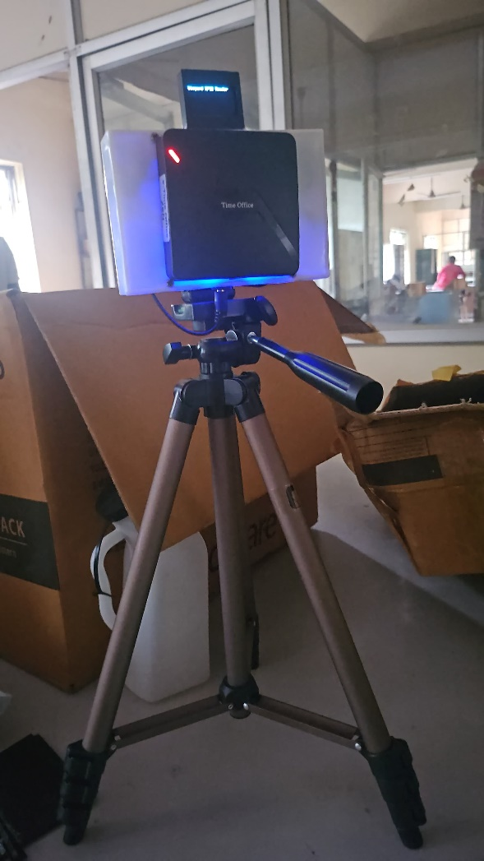
Invention Model

Slide 5
Advantages Of The Invention
The device designed to count the number of people either entering or exiting from the buildings. The data delivered is entirely reliable and with 99 percent accuracy. The device does not require ambient light source as it works effectively in low light environments. No complicated installation required as the device is designed with plug and play mode and operates with battery backup. The device is portable and made with light weight fiber glass material and can be stationed anywhere without depending on external power source.

